Slide 1

AI Mini Project: Color Detection using OpenCV and Python
Team members:
Harshith P (ENG22AM0022)
Harshith G R (ENG22AM0021)
Shivakumar P Gourimath (ENG22AM0061)
Sudarshan H Patil (ENG22AM0063)
Submitted to:
Prof.Pradeep Kumar K

Slide 2
OpenCV, or Open Source Computer Vision Library, is an open-source computer vision and machine learning software library. Originally developed by Intel in 1999, OpenCV has since become one of the most widely used and popular computer vision libraries worldwide. It is written in C++ and provides interfaces for Python, Java, and other languages. A color detection project using OpenCV and Python involves creating a program that can identify and analyze colors within an image or video feed. The project typically includes the following key components:
1. Image Input
2. User Interaction
3. Color Extraction
4. Color Matching
5. Visualization

Slide 3
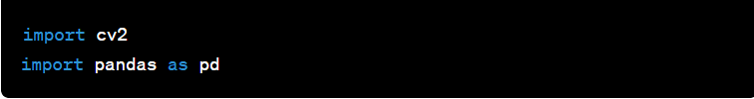

This Python code uses the OpenCV (cv2) and Pandas libraries to create a simple color detection application. Let me break down the code and explain its functionality: Importing Libraries: These lines import the necessary libraries. ‘cv2’ is OpenCV, a computer vision library, and ‘pd’ is an alias for Pandas, a data manipulation library Reading the Image: It reads an image from the specified file path using OpenCV's ‘imread’ function

Slide 4



Global Variables: These are global variables used to store information about the last double-click event on the image. Reading Color Data from CSV: It reads color information from a CSV file ('colors.csv') using Pandas and assigns column names to the data. Color Matching Function: This function calculates the minimum distance from all colors in the CSV file and returns the most matching color name.

Slide 5

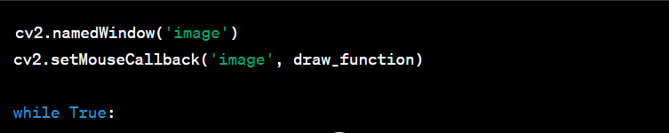
Mouse Double-Click Event Function: This function is called whenever there is a mouse double-click event. It updates the global variables with the color information at the clicked position. Main Loop: It sets up a named window and registers the mouse callback function. The main loop continuously displays the image using OpenCV's imshow and waits for user input.

Slide 6

Displaying Color Information: If a double-click event has occurred, it draws a rectangle with the selected color and displays the color name along with RGB values. The loop exits when the user presses the 'esc' key. Closing Windows: It closes all OpenCV windows when the application is terminated. Overall, this code allows the user to double-click on a color in the displayed image, and it shows the name and RGB values of that color along with a rectangle filled with the selected color. The color information is obtained from a CSV file containing a list of predefined colors and their RGB values.

Slide 7
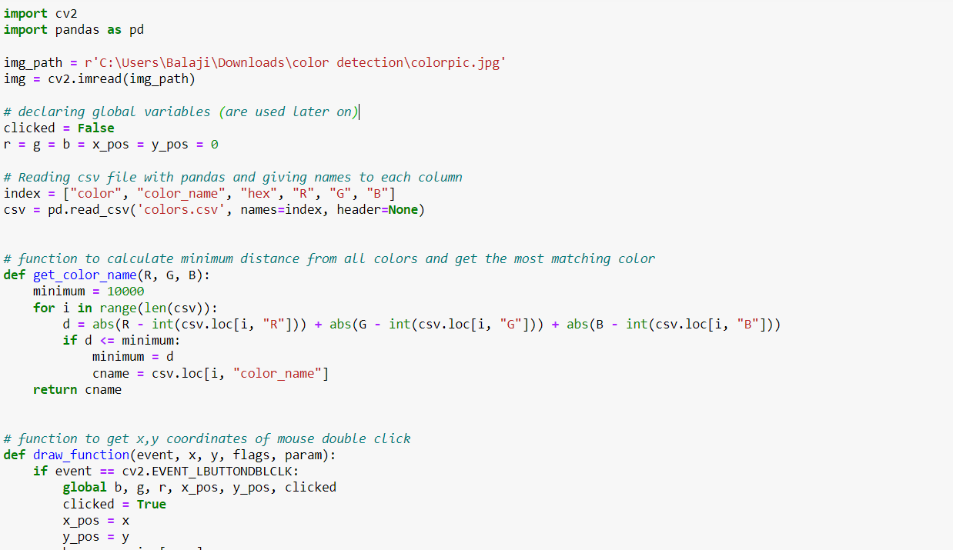

Slide 8
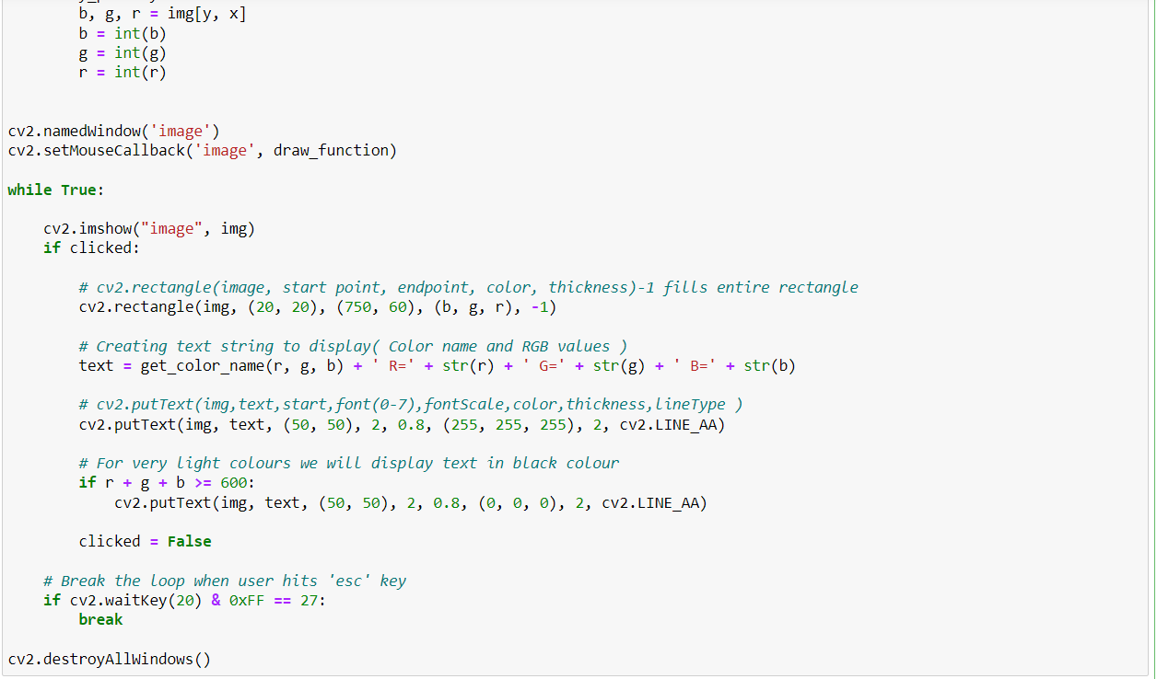

Slide 9
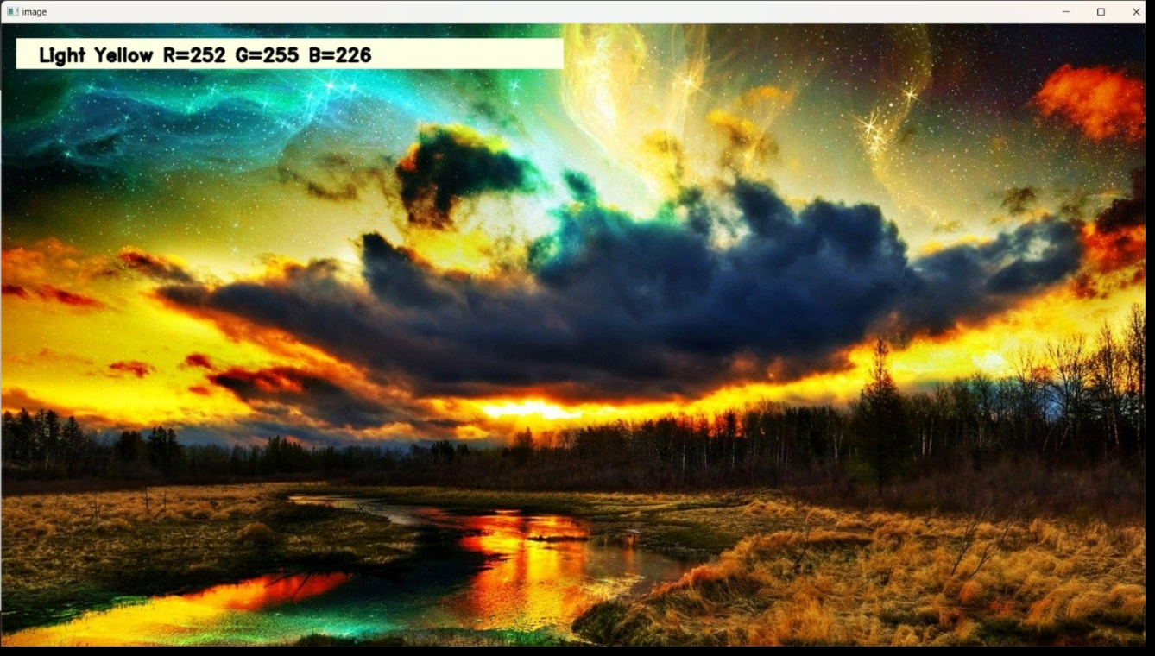
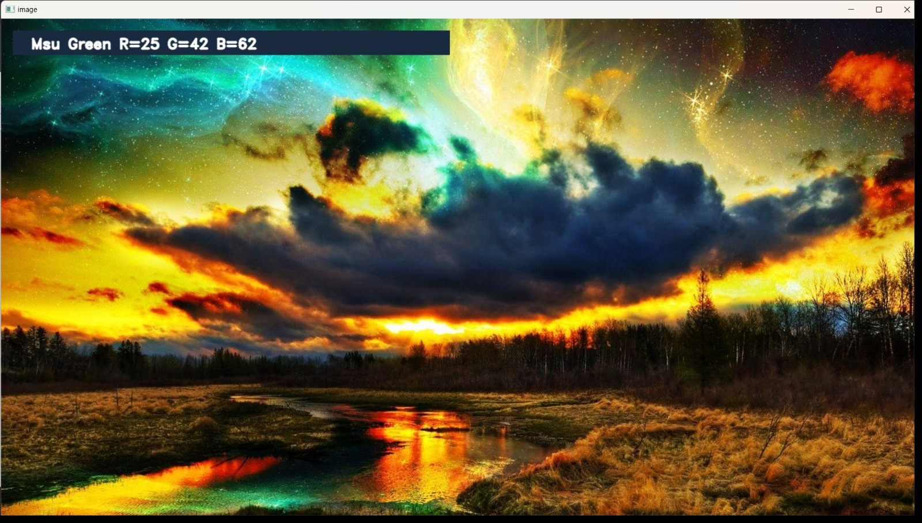
OUTPUT:

Slide 10
Color detection in AI has various applications across different domains. Here are some scenarios where color detection plays a crucial role:
1. Computer Vision and Image Processing
2. Robotics
3. Industrial Automation
4. Medical Imaging
5. Agriculture
6. Augmented Reality (AR) and Virtual Reality (VR)
7. Entertainment

Slide 11
In summary, color detection in AI is essential for a wide range of applications, from improving computer vision tasks to enhancing automation processes and providing valuable information in diverse fields. The ability to accurately detect and interpret colors allows AI systems to make informed decisions and respond intelligently to the surrounding environment. The key takeaways from this project include: > User Interaction > Color Extraction and Matching > Visualization > Real-time Processing > Education Value > Potential Applications > Versatility of OpenCV

Slide 12
THANK YOU

